Slide 1


Slide 2


Directions:
Drag the shapes below over to the word search and use them to circle each word.
Make them longer or shorter to fit around each word.
Take from the pile of marks below to check off each word as you find it.

Slide 3

Directions:
Drag the shapes below over to the word search and use them to circle each word.
Make them longer or shorter to fit around each word.
Take from the pile of marks below to check off each word as you find it.

Slide 4

Directions:
Drag the shapes below over to the word search and use them to circle each word.
Make them longer or shorter to fit around each word.
Take from the pile of marks below to check off each word as you find it.

Slide 5

Directions:
Drag the shapes below over to the word search and use them to circle each word.
Make them longer or shorter to fit around each word.
Take from the pile of marks below to check off each word as you find it.

Slide 6
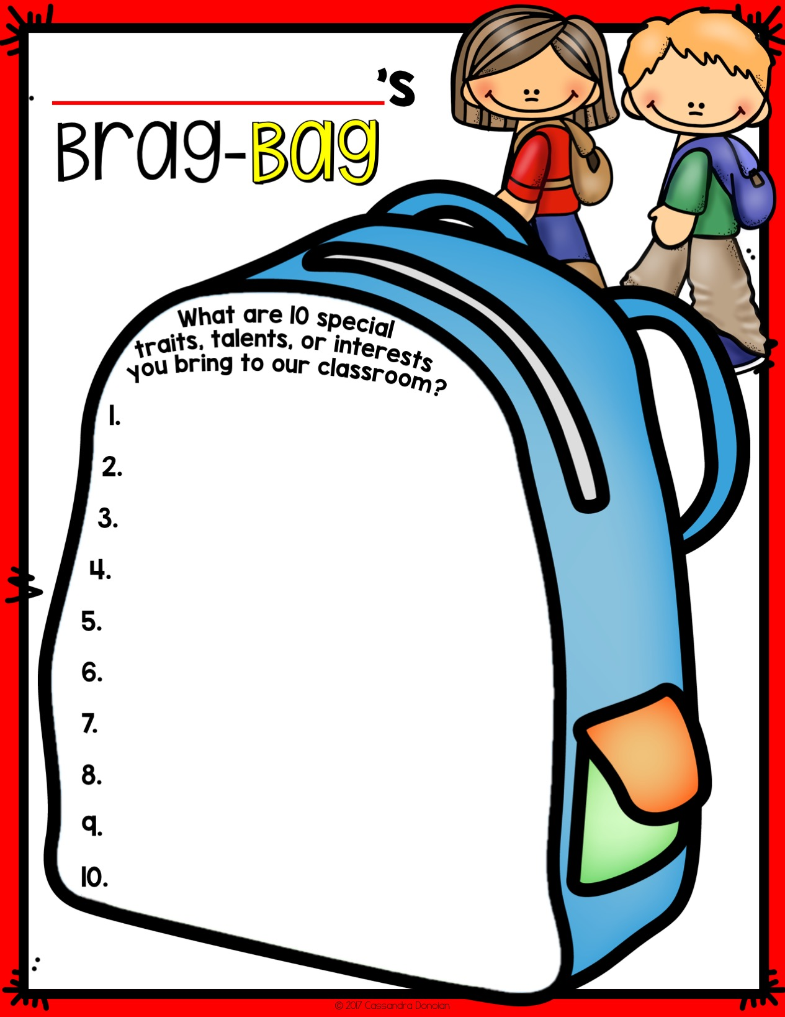

Slide 7
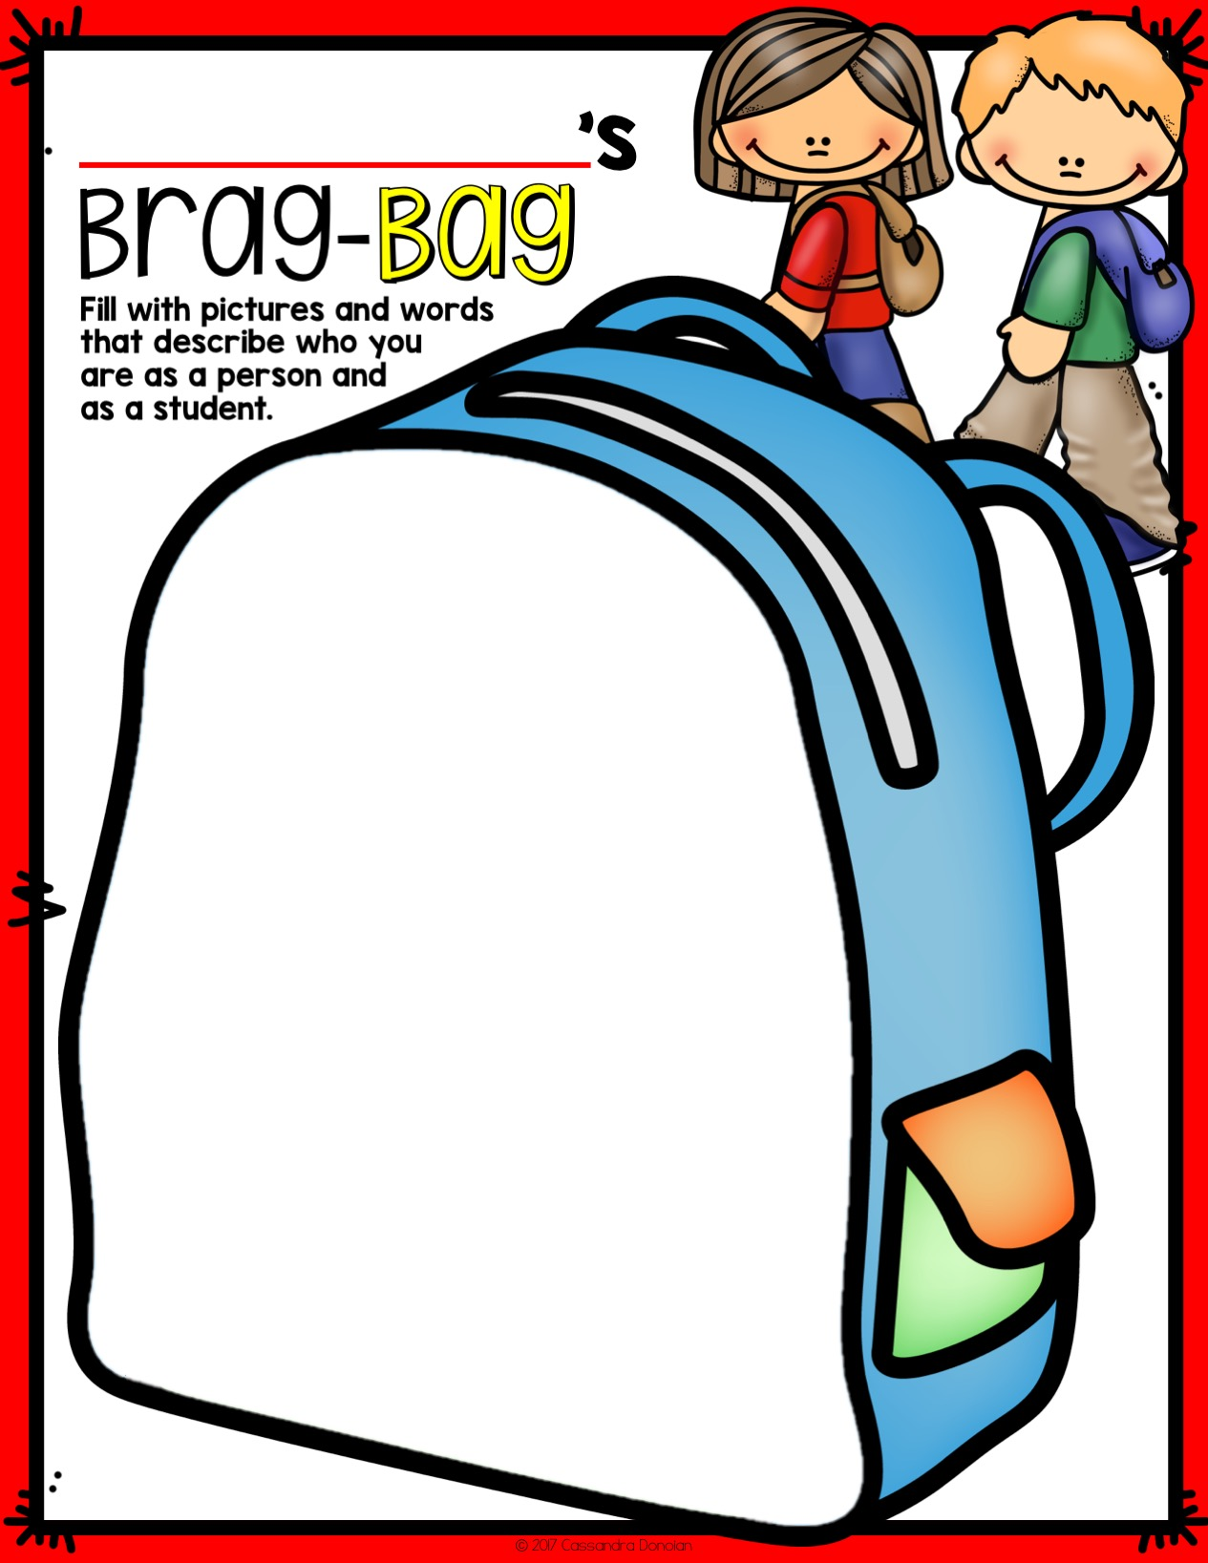

Slide 8
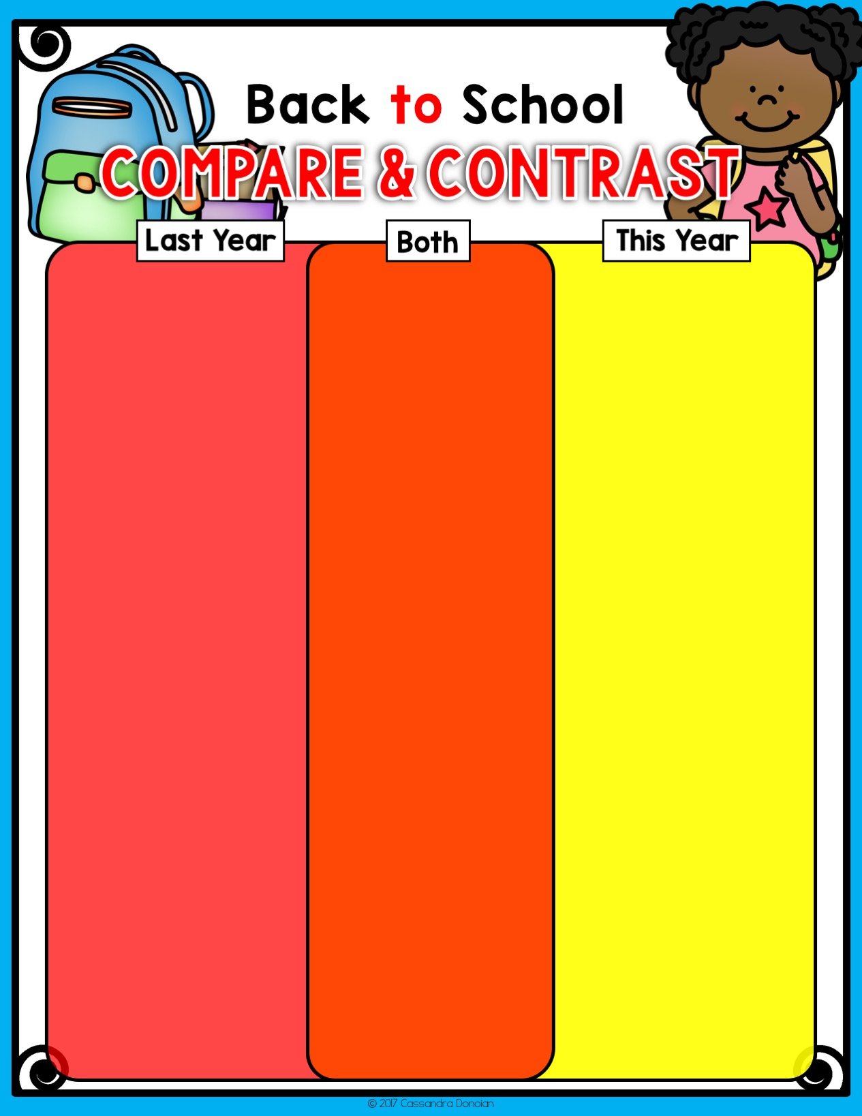

Slide 9


Slide 10


Slide 11
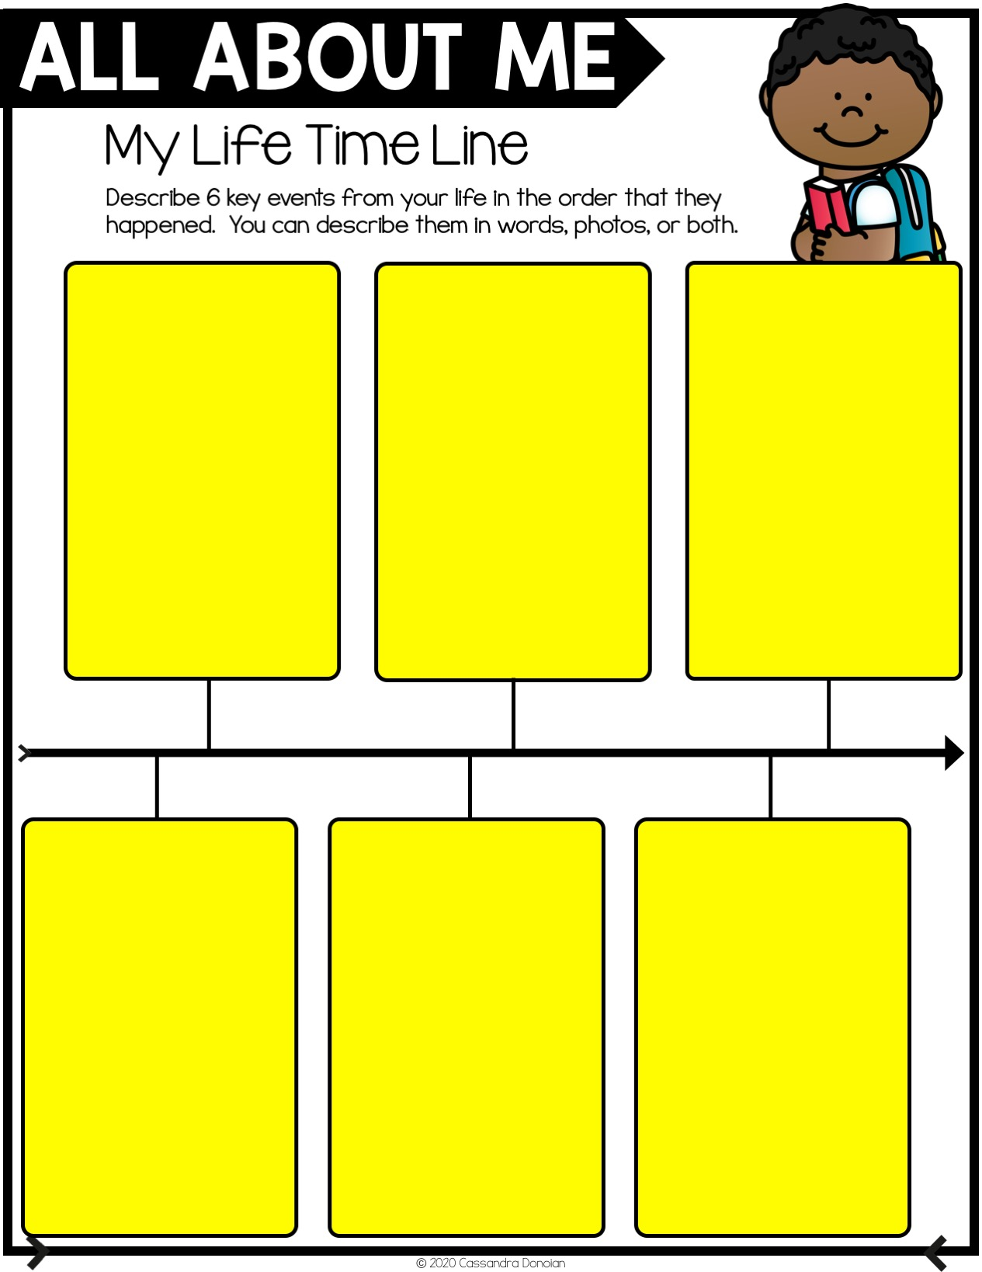

Slide 12


Slide 13


Slide 14


Slide 15


Slide 16


Slide 17


